Slide 1
Cycling Club Registration App
Demo the usage of delegate

Slide 2
Objective
Demo code reuse
Demo design flexibility

Slide 3
Overview
SQLite
Registration App
Store/Retrieve
Retrieved by
Login Form
Read/Modified
SQLite DB Browser
SQLite DB Browser Installer: https://sqlitebrowser.org/dl/

Slide 4
Models – User class
No. | Property Name | Type | Remark
1 | Id | Int | Auto increase
2 | FirstName | String
3 | LastName | String
4 | Password | String
5 | DateOfBirth | DateTime
6 | PhoneNumber | String
7 | AddressFirstLine | String
8 | AddressSecondLine | String
9 | AddressCity | String
10 | Postcode | String

Slide 5
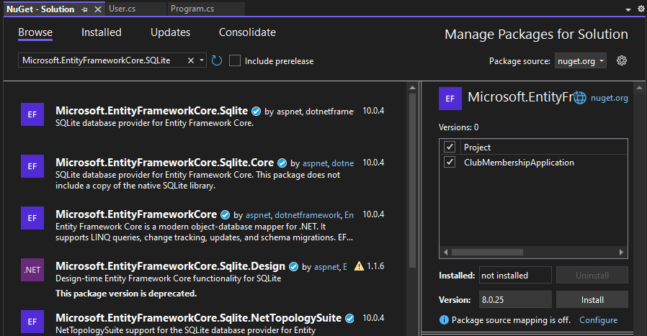
Installing NuGet Package
Tools > Nuget Package Manager > Manage NuGet Package Manager for Solution …
Select this
Tick
Choose correct version before install

Slide 6
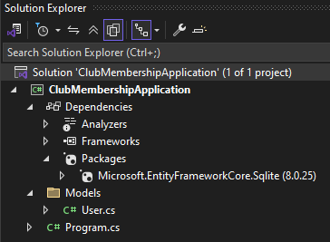
Validate the Package

Slide 7
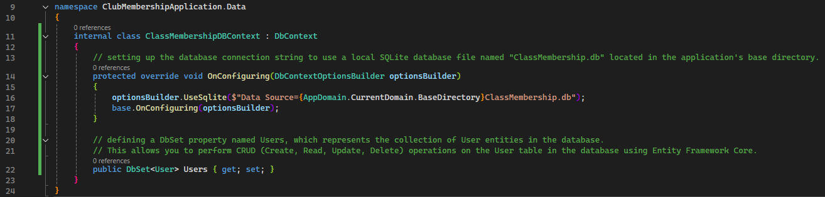
DbContext – create the connection to database

Slide 8
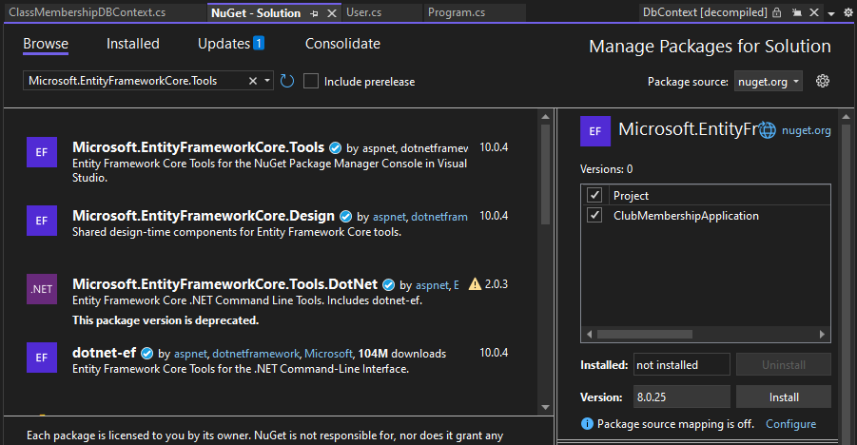
Installing NuGet Package for DB Migration
Select this
Tick
Choose correct version before install
Refer Validate the Package slide on how to validate if installation success

Slide 9
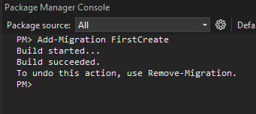
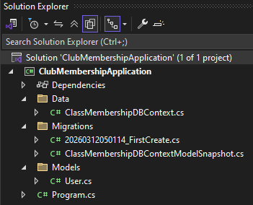
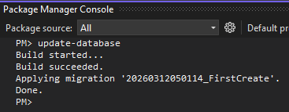
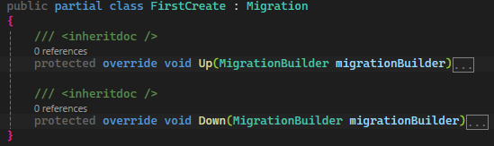
Migration – version control for Db schema
Tools > Nuget Package Manager > Package Manager Console
Created the Migrations class
Create the table
Create user table
Drop user table

Slide 10
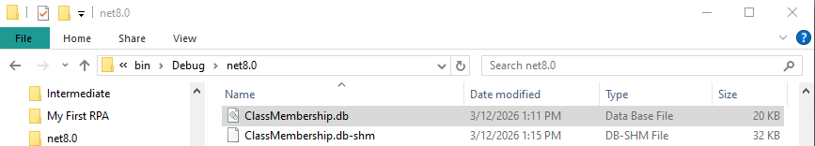
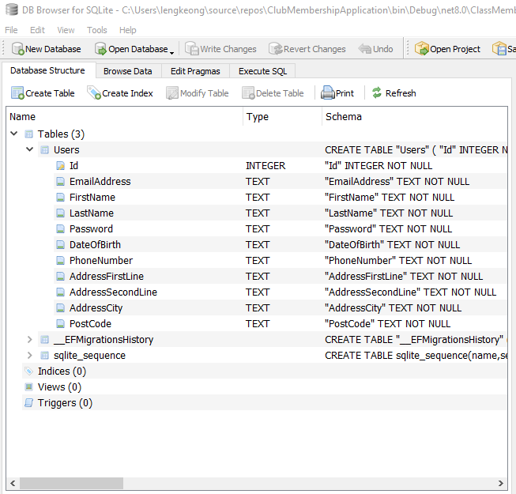
Check the Database
Browse with DB Browser

Slide 11
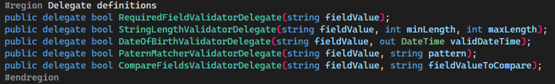
FieldValidatorAPI – CommonFiledValidatorFunctions
This delegate can reference any method that take a single string parameter and return bool
Delegate Definitions

Slide 12
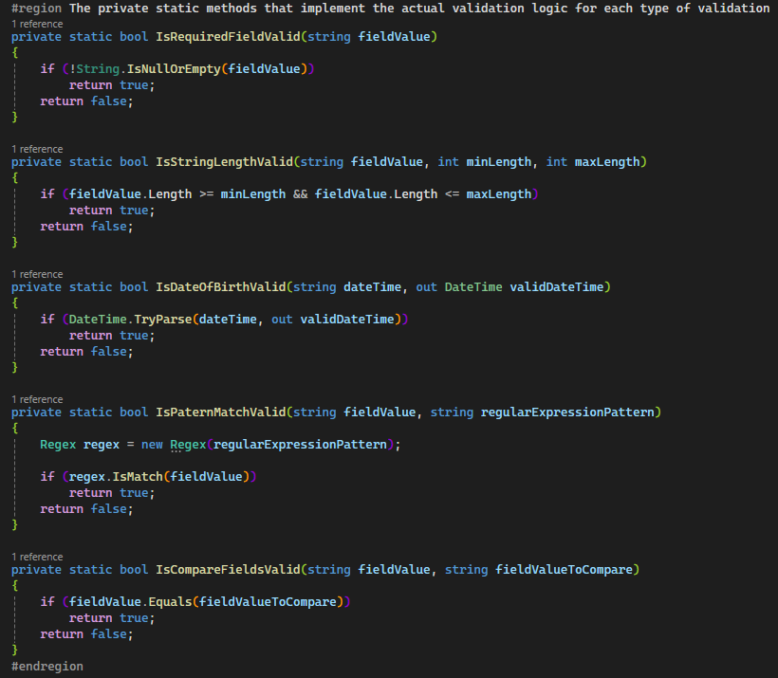
FieldValidatorAPI – CommonFiledValidatorFunctions
Methods that implement the actual validation logic

Slide 13
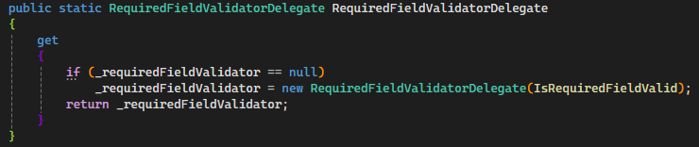
FieldValidatorAPI – CommonFiledValidatorFunctions
The reference (variable)
Prevent the user from pointing the delegate to other function and only use the function controlled in get property.
Lazy Loading: only create the instance when someone calls the get for the first time.
The method
Lazy initialization of the delegate instance. This approach also known as Singleton as it only ONE instance created. Thus, it always return the instance which is created at first time.

Slide 14
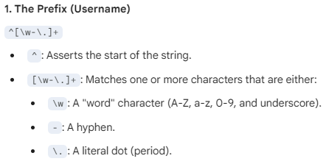

FieldValidatorAPI – CommonRegularExpressionValidationPatterns

Slide 15
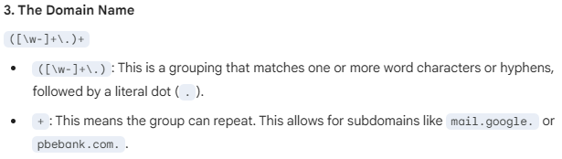
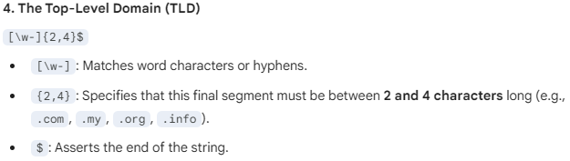
FieldValidatorAPI – CommonRegularExpressionValidationPatterns

Slide 16
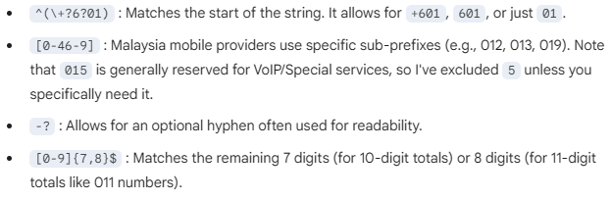
FieldValidatorAPI – CommonRegularExpressionValidationPatterns
-? Means allow zero or one hyphens
-* Means allow zero or more hyphens

Slide 17

FieldValidatorAPI – CommonRegularExpressionValidationPatterns
Without ^ and $ ,
user can enter more than 5 digits or as long as there were 5 digits match in between
^ and $ are known as Anchors

Slide 18
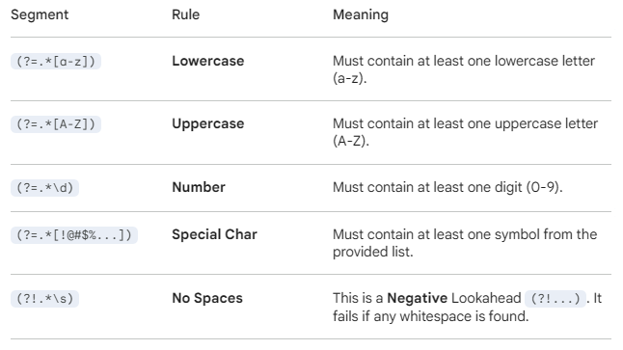
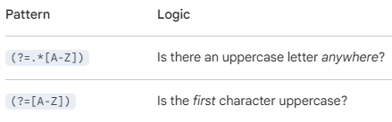
FieldValidatorAPI – CommonRegularExpressionValidationPatterns
?= is the Lookahead syntax.
.* means any character appear 0 or more times

